Slide 1

Operating system

Slide 2
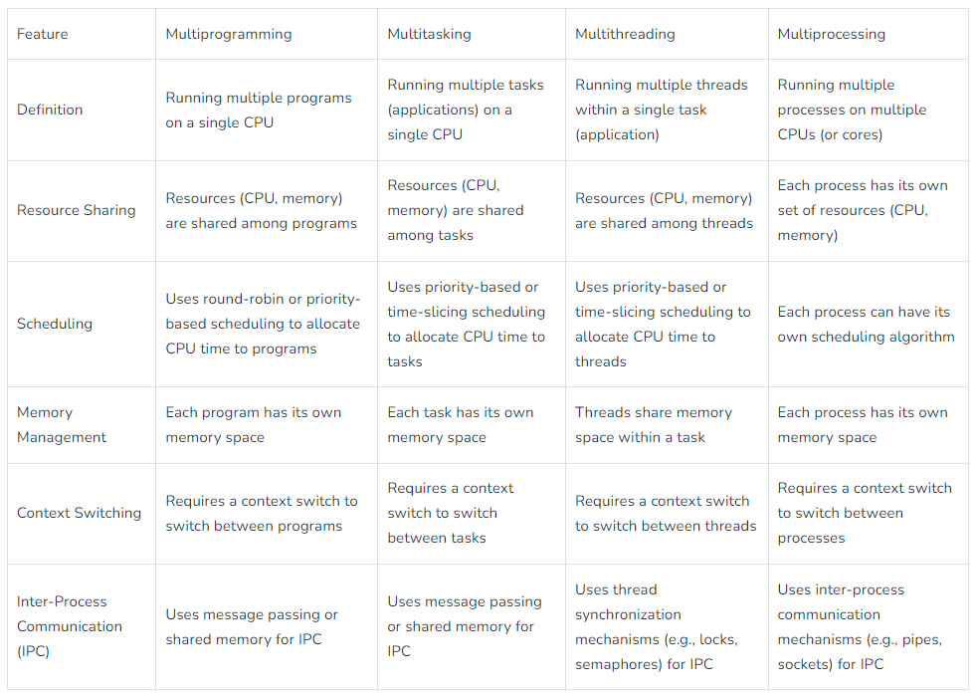

Slide 3
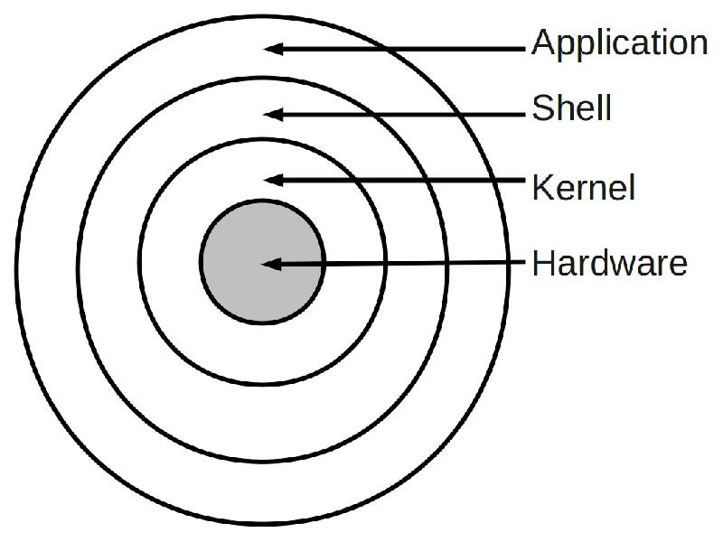
Operating system architecture
S
An operating system is a program that acts as an interface between a user of a computer and the computer resources. The purpose of an operating system is to provide an environment in which a user may execute programs.
Hardware: The hardware consists of the memory, CPU, arithmetic-logic unit, various bulk storage devices, I/O, peripheral devices and other physical devices.

Slide 4
Operating system architecture
S
Kernel:
In computing, the kernel is the central component of most computer operating systems;
it is a bridge between applications and the actual data processing done at the hardware level.
It typically makes these facilities available to application processes through inter-process communication mechanisms and system calls.
Shell:
A shell is a piece of software that provides an interface for users to an operating system that provides access to the services of a kernel.
The name shell originates from shells being an outer layer of interface between the user and the innards of the operating system (the kernel)
Operating system shells generally fall into one of two categories: command-line and graphical

Slide 5
Monolithic Structure of Operating System
S
The monolithic operating system is a very basic operating system in which file management, memory management, device management, and process management are directly controlled within the kernel.
Operating systems that use monolithic architecture were first time used in the 1970s.
The monolithic operating system is also known as the monolithic kernel.
A monolithic kernel is an operating system architecture where the entire operating system is working in kernel space.

Slide 6
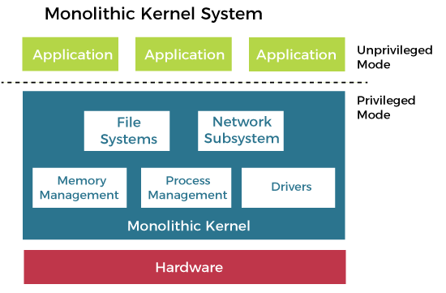
Monolithic System Architecture
S
A monolithic design of the operating system architecture makes no special accommodation for the special nature of the operating system.
Although the design follows the separation of concerns, no attempt is made to restrict the privileges granted to the individual parts of the operating system.
The entire operating system executes with maximum privileges. The communication overhead inside the monolithic operating system is the same as that of any other software, considered relatively low.

Slide 7
Advantages of Monolithic Kernel
S
The execution of the monolithic kernel is quite fast as the services such as memory management, file management, process scheduling etc. are implemented under the same address space.
A process runs completely in a single address space in the monolithic kernel.
The monolithic kernel is a static single binary file.
disAdvantages of Monolithic Kernel
If any service fails in the monolithic kernel, it leads to the failure of the entire system.
To add any new service, the entire operating system needs to be modified by the user.

Slide 8
layered OS architecture
S
The modularity of layered operating systems allows the implementation of each layer to be modified without requiring any modification to adjacent layers.
It was created to improve the pre-existing structures like the Monolithic structure ( UNIX ) and the Simple structure ( MS-DOS ).
Example – The Windows NT operating system uses this layered approach as a part of it.
The outermost layer must be the User Interface layer.
The innermost layer must be the Hardware layer.
A particular layer can access all the layers present below it but it cannot access the layers present above it. That is layer n-1 can access all the layers from n-2 to 0 but it cannot access the nth layer.

Slide 9
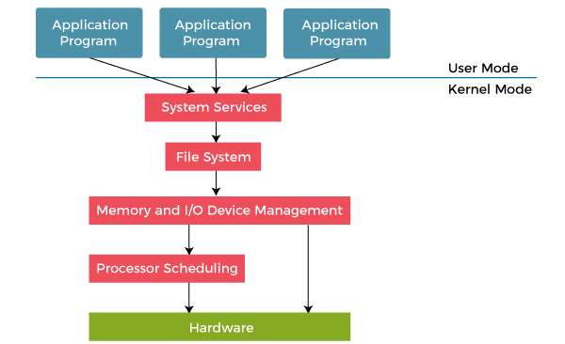
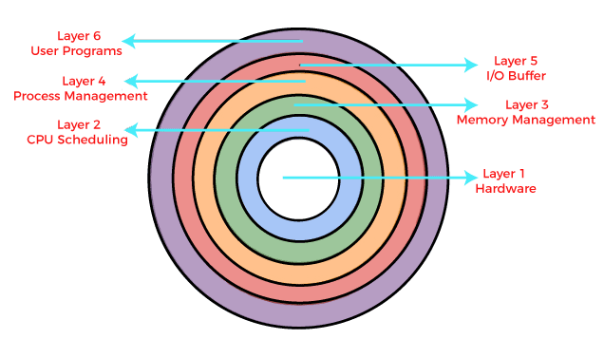
layered OS architecture
S

Slide 10
Advantages: layered OS architecture
S
Modularity : This design promotes modularity as each layer performs only the tasks it is scheduled to perform.
Easy debugging : As the layers are discrete so it is very easy to debug. Suppose an error occurs in the CPU scheduling layer, so the developer can only search that particular layer to debug, unlike the Monolithic system in which all the services are present together.
Easy update : A modification made in a particular layer will not affect the other layers.
No direct access to hardware : The hardware layer is the innermost layer present in the design. So a user can use the services of hardware but cannot directly modify or access it, unlike the Simple system in which the user had direct access to the hardware.
Abstraction : Every layer is concerned with its own functions. So the functions and implementations of the other layers are abstract to it

Slide 11
disadvantage: layered OS architecture
S
Complex and careful implementation: As a layer can access the services of the layers below it, so the arrangement of the layers must be done carefully. For example, the backing storage layer uses the services of the memory management layer. So it must be kept below the memory management layer. Thus with great modularity comes complex implementation.
Slower in execution: If a layer wants to interact with another layer, it requests to travel through all the layers present between the two interacting layers. Thus it increases response time, unlike the Monolithic system, which is faster than this. Thus an increase in the number of layers may lead to a very inefficient design.
Functionality: It is not always possible to divide the functionalities. Many times, they are interrelated and can't be separated.
Communication: No communication between non-adjacent layers.

Slide 12
microkernel OS architecture
S
A microkernel architecture includes only a very small number of services within the kernel in an attempt to keep it small and scalable.
The services typically include low-level memory management, inter-process communication and basic process synchronisation to enable processes to cooperate.
In microkernel designs, most operating system components, such as process management and device management, execute outside the kernel with a lower level of system access.
Microkernels are highly modular, making them extensible, portable and scalable. Operating system components outside the kernel can fail without causing the operating system to fall over..

Slide 13
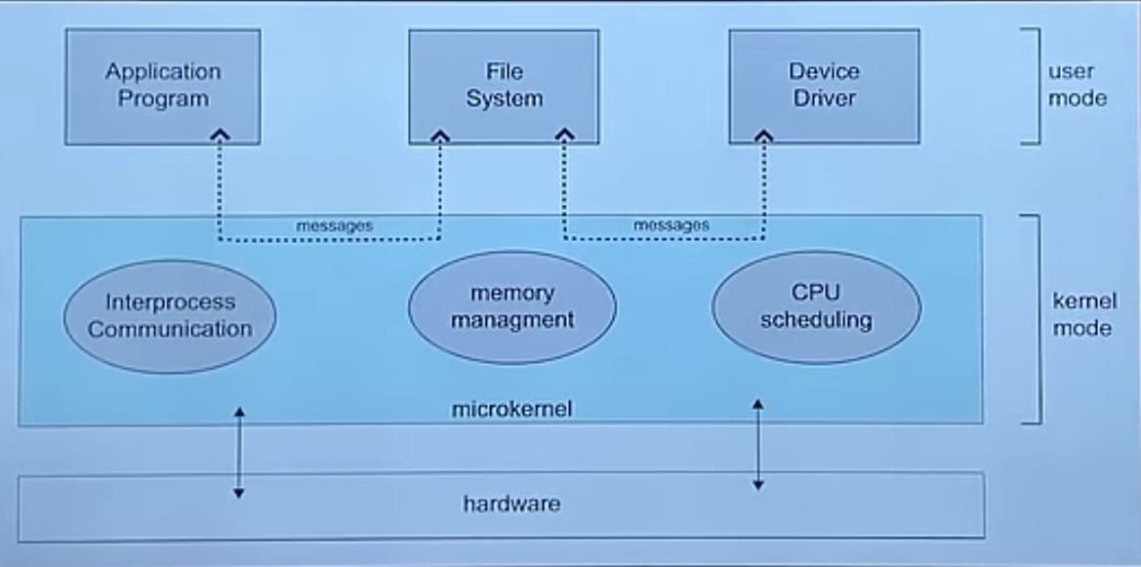
microkernel OS architecture
S

Slide 14
Advantages: microkernel OS architecture
S
Microkernels are secure since only those parts are added, which might disturb the system's functionality.
Microkernels are modular, and the various modules may be swapped, reloaded, and modified without affecting the kernel.
Microkernel architecture is compact and isolated, so it may perform better.
The system expansion is more accessible, so it may be introduced to the system application without disrupting the kernel.
When compared to monolithic systems, microkernels have fewer system crashes. Furthermore, due to the modular structure of microkernels, any crashes that do occur are simply handled.
The microkernel interface helps in enforcing a more modular system structure.
Server failure is treated the same as any other user program failure.
It adds new features without recompiling.

Slide 15
Disadvantages: microkernel OS architecture
S
When the drivers are implemented as procedures, a context switch or a function call is needed.
In a microkernel system, providing services are more costly than in a traditional monolithic system.
The performance of a microkernel system might be indifferent and cause issues.

Slide 16
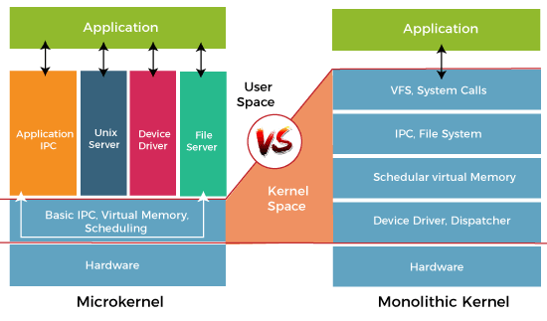

Slide 17
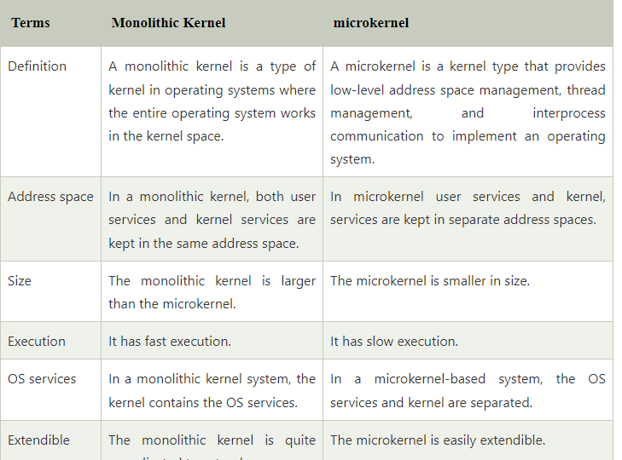
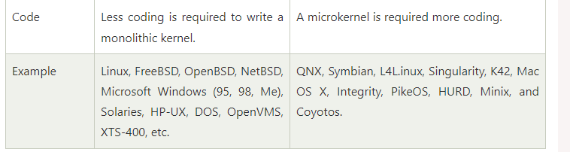

Slide 18
Virtual Machines
S
A virtual machine takes the layered approach to its logical conclusion. It treats hardware and the operating system kernel as though they were all hardware.
A virtual machine provides an interface identical to the underlying bare hardware.
The operating system creates the illusion of multiple processes, each executing on its own processor with its own (virtual) memory
The resources of the physical computer are shared to create the virtual machines.
✦ CPU scheduling can create the appearance that users have their own processor.
✦ Spooling and a file system can provide virtual card readers and virtual line printers.
✦ A normal user time-sharing terminal serves as the virtual machine operator’s console.

Slide 19
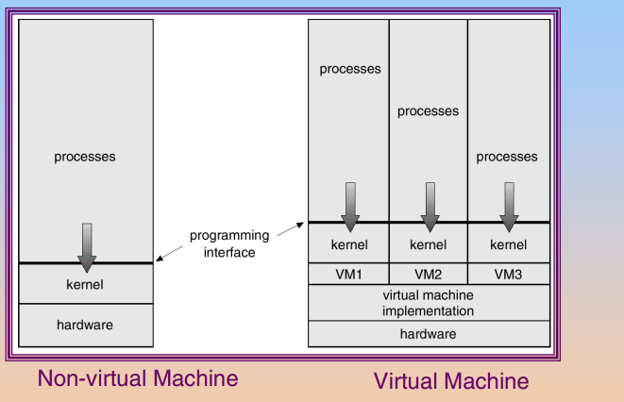
Virtual Machines
S

Slide 20
Advantages/Disadvantages of Virtual Machines
S
The virtual-machine concept provides complete protection of system resources since each virtual machine is isolated from all other virtual machines. This isolation, however, permits no direct sharing of resources.
A virtual-machine system is a perfect vehicle for operating-systems research and development. System development is done on the virtual machine, instead of on a physical machine and so does not disrupt normal system operation.
The virtual machine concept is difficult to implement due to the effort required to provide an exact duplicate to the underlying machine.

Slide 21
Thank You

